Slide 1



Motive System for ROAR
Amy Kaczmarowski, Ira A. Fulton School of Engineering
Phil Christensen, Mentor, School of Earth and Space Exploration
Arizona State University, NASA Space Grant, Robotics Team

Slide 2
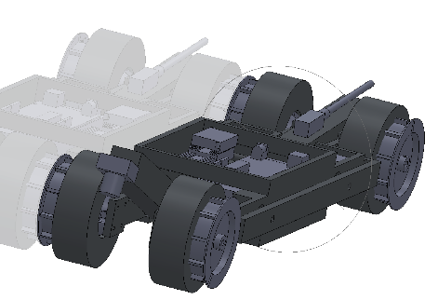
ROAR
Small Versatile Robot
Tough terrain
Scientific Measurements
Mobility

Slide 3
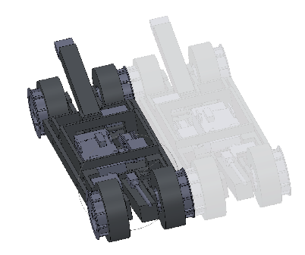
Design Parameters
Fit with a 6in diameter rocket
Survive landing and be able to move afterwards
Stay within a given budget

Slide 4
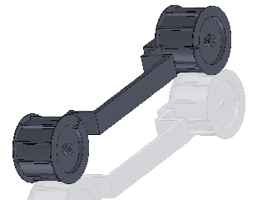
Tread System
Maximize Surface area
Maximize Torque
2 Drive Wheels
Timing Belts and Timing Motors

Slide 5
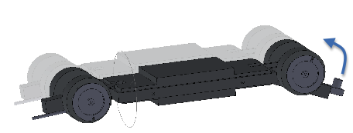
Reversibility
Treads will encase robot
Allow it to flip over
More landing options

Slide 6
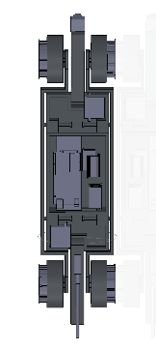
Spring Design
Compact while in rocket tube
Maximize turning radius

Slide 7
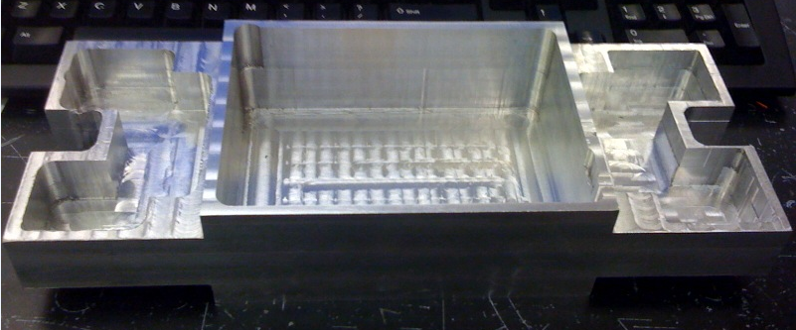
Updates
Began work on body
Purchased controls
Lots of Team development

